Slide 1
Chapter 7
Entropy: A Measure of Disorder
Study Guide in PowerPoint
to accompany
Thermodynamics: An Engineering Approach, 5th edition
by Yunus A. Çengel and Michael A. Boles

Slide 2
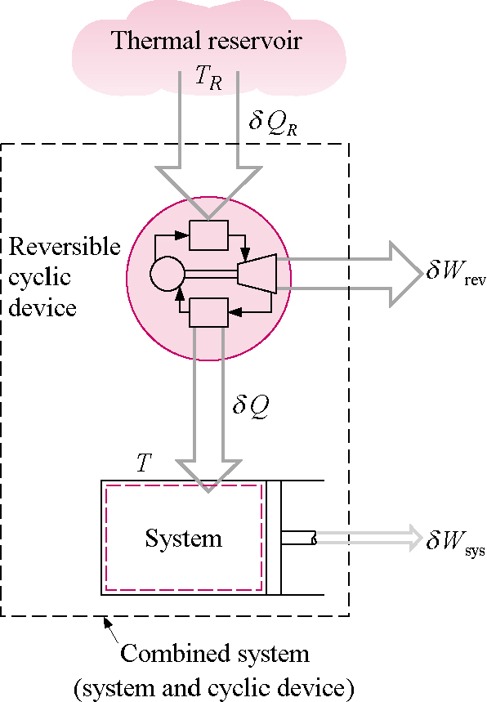
Entropy and the Clausius Inequality
The second law of thermodynamics leads to the definition of a new property called entropy, a quantitative measure of microscopic disorder for a system. Entropy is a measure of energy that is no longer available to perform useful work within the current environment. To obtain the working definition of entropy and, thus, the second law, let's derive the Clausius inequality.
Consider a heat reservoir giving up heat to a reversible heat engine, which in turn gives up heat to a piston-cylinder device as shown below.

Slide 3
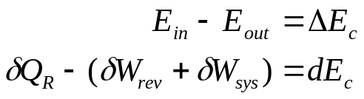
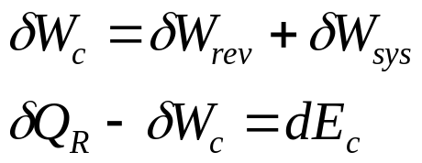
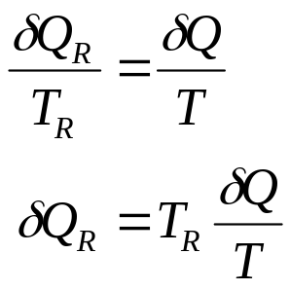
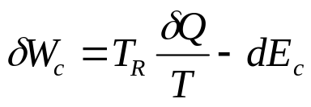
We apply the first law on an incremental basis to the combined system composed of the heat engine and the system.
where E_{c} is the energy of the combined system. Let W_{c} be the work done by the combined system. Then the first law becomes
If we assume that the engine is totally reversible, then
The total net work done by the combined system becomes

Slide 4
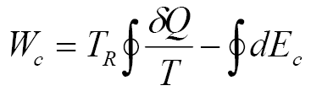

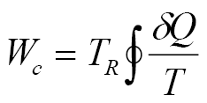
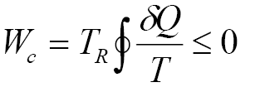
Now the total work done is found by taking the cyclic integral of the incremental work.
If the system, as well as the heat engine, is required to undergo a cycle, then
and the total net work becomes
If W_{c} is positive, we have a cyclic device exchanging energy with a single heat reservoir and producing an equivalent amount of work; thus, the Kelvin-Planck statement of the second law is violated. But W_{c} can be zero (no work done) or negative (work is done on the combined system) and not violate the Kelvin-Planck statement of the second law. Therefore, since T_{R} > 0 (absolute temperature), we conclude

Slide 5
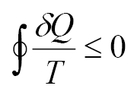
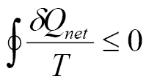
or
Here Q is the net heat added to the system, Q_{net}.
This equation is called the Clausius inequality. The equality holds for the reversible process and the inequality holds for the irreversible process.
Example 7-1
For a particular power plant, the heat added and rejected both occur at constant temperature and no other processes experience any heat transfer. The heat is added in the amount of 3150 kJ at 440oC and is rejected in the amount of 1950 kJ at 20oC. Is the Clausius inequality satisfied and is the cycle reversible or irreversible?

Slide 6
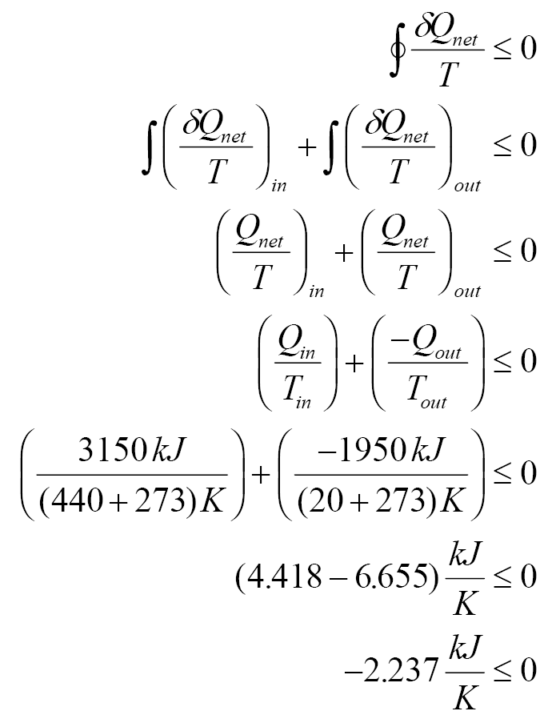
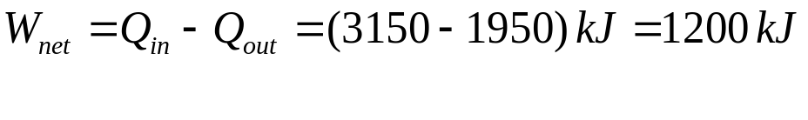
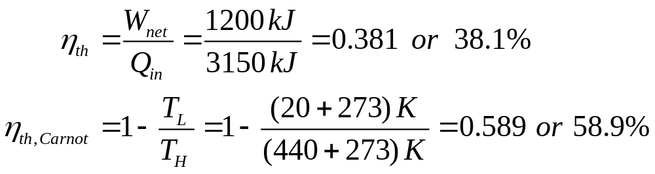
Calculate the net work, cycle efficiency, and Carnot efficiency based on T_{H} and T_{L} for this cycle.

Slide 7
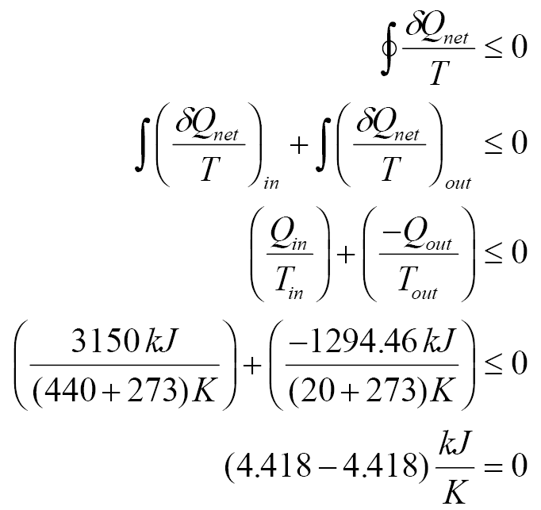
The Clausius inequality is satisfied. Since the inequality is less than zero, the cycle has at least one irreversible process and the cycle is irreversible.
Example 7-2
For a particular power plant, the heat added and rejected both occur at constant temperature; no other processes experience any heat transfer. The heat is added in the amount of 3150 kJ at 440oC and is rejected in the amount of 1294.46 kJ at 20oC. Is the Clausius inequality satisfied and is the cycle reversible or irreversible?

Slide 8
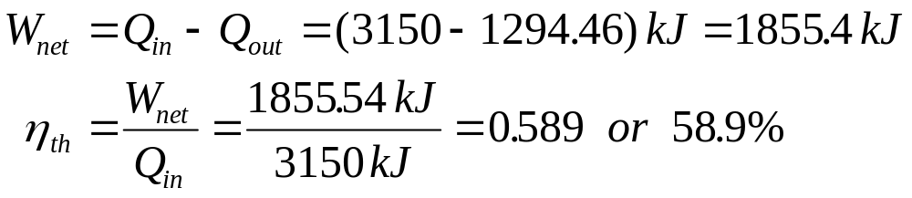
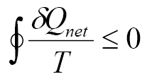
The Clausius inequality is satisfied. Since the cyclic integral is equal to zero, the cycle is made of reversible processes. What cycle can this be?
Calculate the net work and cycle efficiency for this cycle.
Definition of Entropy
Let’s take another look at the quantity
If no irreversibilities occur within the system as well as the reversible cyclic device, then the cycle undergone by the combined system will be inter­nally reversible. As such, it can be reversed. In the reversed cycle case, all the quantities will have the same magnitude but the opposite sign. Therefore, the work W_{C}, which could not be a positive quantity in the regular case, cannot be a negative quantity in the reversed case. Then it follows that
W_{C,int rev} = 0 since it cannot be a positive or negative quantity, and therefore

Slide 9
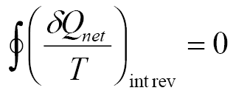
for internally reversible cycles. Thus we conclude that the equality in the Clausius inequality holds for totally or just internally reversible cycles and the inequality for the irreversible ones.
To develop a relation for the definition of entropy, let us examine this last equation more closely. Here we have a quantity whose cyclic integral is zero. Let us think for a moment what kind of quantities can have this characteristic. We know that the cyclic integral of work is not zero. (It is a good thing that it is not. Otherwise, heat engines that work on a cycle such as steam power plants would produce zero net work.) Neither is the cyclic integral of heat.
Now consider the volume occupied by a gas in a piston-cylinder device undergoing a cycle, as shown below.

Slide 10
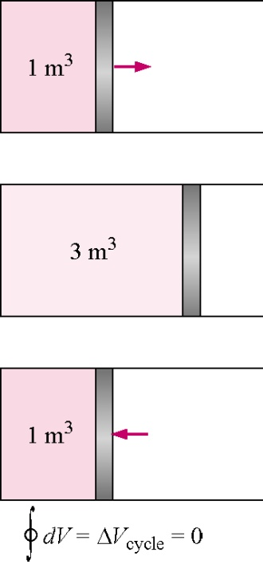

When the piston returns to its initial position at the end of a cycle, the volume of the gas also returns to its initial value. Thus the net change in volume during a cycle is zero. This is also expressed as
We see that the cyclic integral of a property is zero. A quantity whose cyclic integral is zero depends only on the state and not on the process path; thus it is a property. Therefore the quantity (δQ_{net}/T)_{int rev} must be a property.

Slide 11
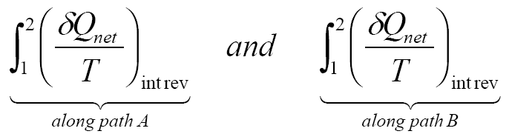
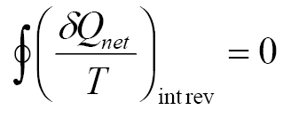
In-class Example
Consider the cycle shown below composed of two reversible processes A and B. Apply the Clausius inequality for this cycle. What do you conclude about these two integrals?
P
2
B
A
1
V
A cycle composed of two reversible processes.
Apply the Clausius inequality for the cycle made of two internally reversible processes:

Slide 12
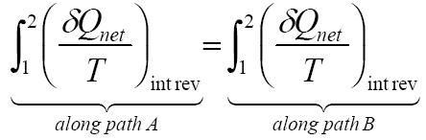
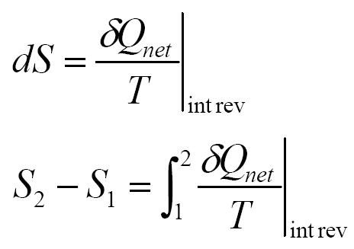
You should find:
Since the quantity (δQ_{net}/T)_{int rev} is independent of the path and must be a property, we call this property the entropy S.
The entropy change occurring during a process is related to the heat transfer and the temperature of the system. The entropy is given the symbol S (kJ/K), and the specific entropy is s (kJ/kg⋅K).
The entropy change during a reversible process, sometimes called an internally reversible process, is defined as

Slide 13
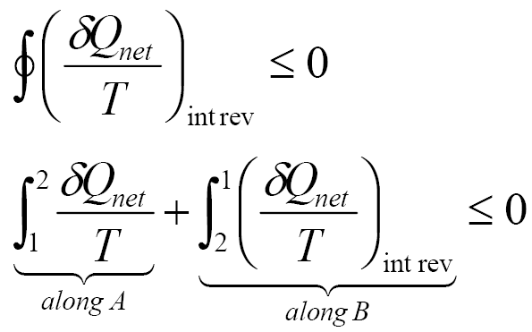
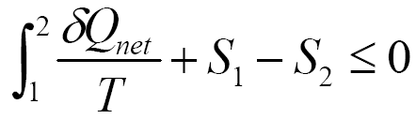
Consider the cycle 1-A-2-B-1, shown below, where process A is arbitrary that is, it can be either reversible or irreversible, and process B is internally reversible.
P
2
B
A
1
V
A cycle composed of reversible and irreversible processes.
The integral along the internally reversible path, process B, is the entropy change
S₁ –S₂. Therefore,

Slide 14
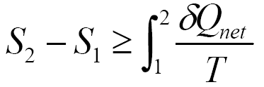
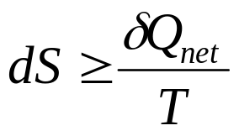
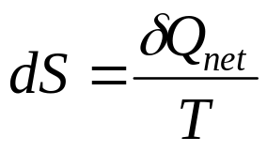
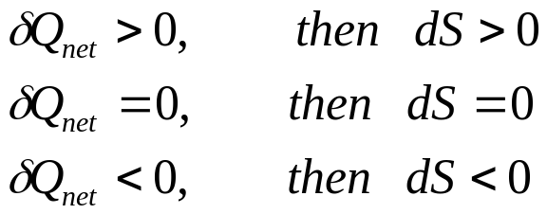
or
In general the entropy change during a process is defined as
where = holds for the internally reversible process
> holds for the irreversible process
Consider the effect of heat transfer on entropy for the internally reversible case.
Which temperature T is this one? If

Slide 15
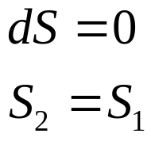
This last result shows why we have kept the subscript net on the heat transfer Q. It is important for you to recognize that Q has a sign depending on the direction of heat transfer. The net subscript is to remind us that Q is positive when added to a system and negative when leaving a system. Thus, the entropy change of the system will have the same sign as the heat transfer in a reversible process.
From the above, we see that for a reversible, adiabatic process
The reversible, adiabatic process is called an isentropic process.
Entropy change is caused by heat transfer and irreversibilities. Heat transfer to a system increases the entropy; heat transfer from a system decreases it. The effect of irreversibilities is always to increase the entropy. In fact, a process in which the heat transfer is out of the system may be so irreversible that the actual entropy change is positive. Friction is one source of irreversibilities in a system.
The entropy change during a process is obtained by integrating the dS equation over the process:

Slide 16
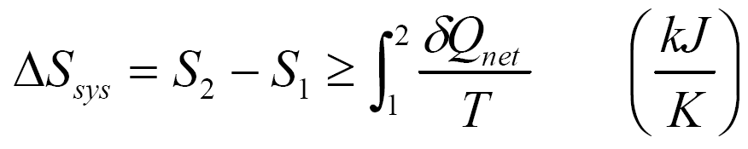

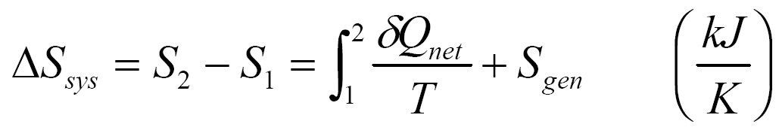

Here, the inequality is to remind us that the entropy change of a system during an irreversible process is always greater than , called the entropy transfer. That is, some entropy is generated or created during an irreversible process, and this generation is due entirely to the presence of irreversibilities. The entropy generated during a process is called entropy generation and is denoted as S_{gen}.
We can remove the inequality by noting the following
S_{gen} is always a positive quantity or zero. Its value depends upon the process and thus it is not a property. S_{gen} is zero for an internally reversible process.
The integral is performed by applying the first law to the process to obtain the heat transfer as a function of the temperature. The integration is not easy to perform, in general.

Slide 17
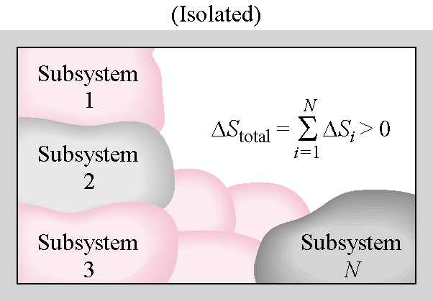
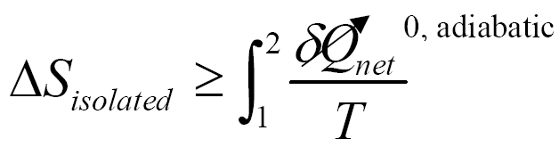

Definition of Second Law of Thermodynamics
Now consider an isolated system composed of several subsystems exchanging energy among themselves. Since the isolated system has no energy transfer across its system boundary, the heat transfer across the system boundary is zero.
Applying the definition of entropy to the isolated system
The total entropy change for the isolated system is

Slide 18
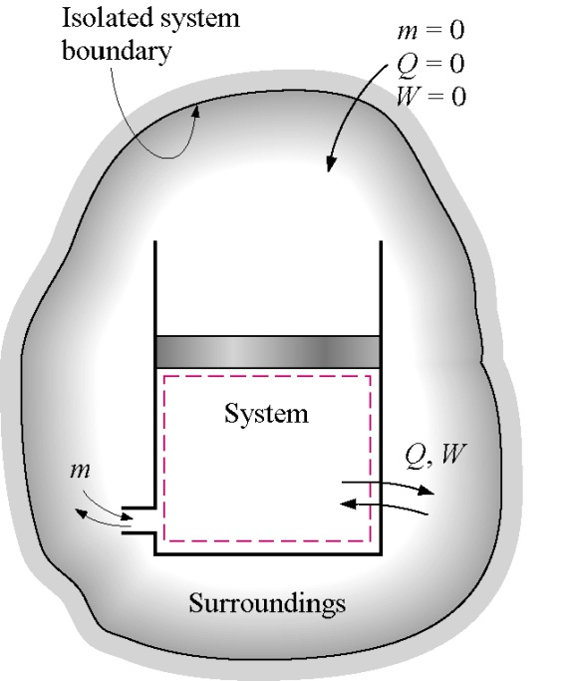
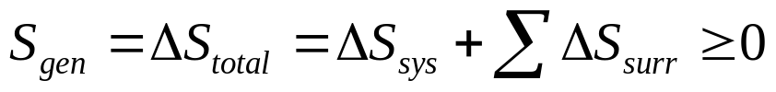
This equation is the working definition of the second law of thermodynamics. The second law, known as the principle of increase of entropy, is stated as
The total entropy change of an isolated system during a process always increases or, in the limiting case of a reversible process, remains constant.
Now consider a general system exchanging mass as well as energy with its surroundings.

Slide 19
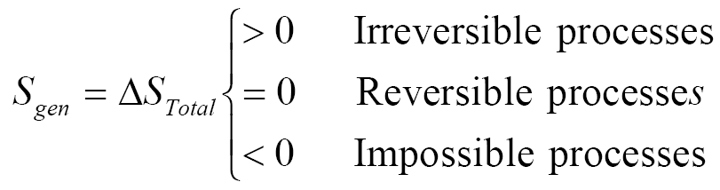
where = holds for the totally reversible process
> holds for the irreversible process
Thus, the entropy generated or the total entropy change (sometimes called the entropy change of the universe or net entropy change) due to the process of this isolated system is positive (for actual processes) or zero (for reversible processes). The total entropy change for a process is the amount of entropy generated during that process (S_{gen}), and it is equal to the sum of the entropy changes of the system and the surroundings. The entropy changes of the important system (closed system or control volume) and its surroundings do not both have to be positive. The entropy for a given system (important or surroundings) may decrease during a process, but the sum of the entropy changes of the system and its surroundings for an isolated system can never decrease.
Entropy change is caused by heat transfer and irreversibilities. Heat transfer to a system increases the entropy, and heat transfer from a system decreases it. The effect of irreversibilities is always to increase the entropy.
The increase in entropy principle can be summarized as follows:

Slide 20
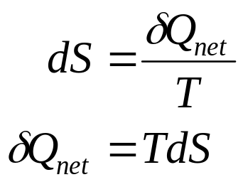
Some Remarks about Entropy
Processes can occur in a certain direction only, not in just any direction, such that S_{gen}≥0.
Entropy is a nonconserved property, and there is no such thing as the conservation of entropy principle. The entropy of the universe is continuously increasing.
The performance of engineering systems is degraded by the presence of irreversibilities, and entropy generation is a measure of the magnitudes of the irreversibilities present during that process.
Heat Transfer as the Area under a T-S Curve
For the reversible process, the equation for dS implies that
or the incremental heat transfer in a process is the product of the temperature and the differential of the entropy, the differential area under the process curve plotted on the T-S diagram.

Slide 21
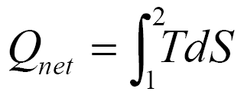
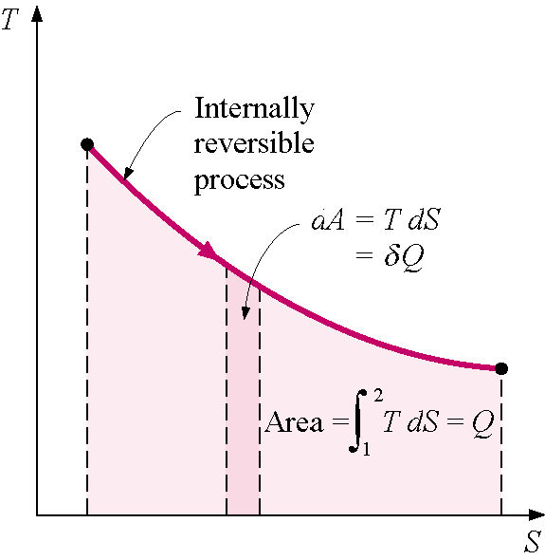
In the above figure, the heat transfer in an internally reversible process is shown as the area under the process curve plotted on the T-S diagram.
Isothermal, Reversible Process
For an isothermal, reversible process, the temperature is constant and the integral to find the entropy change is readily performed. If the system has a constant temperature, T₀, the entropy change becomes

Slide 22
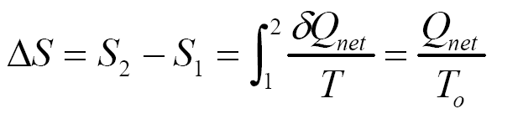
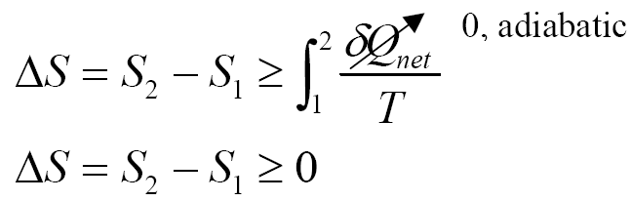
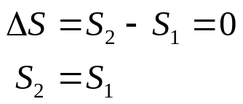
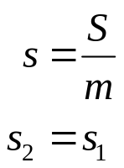
For a process occurring over a varying temperature, the entropy change must be found by integration over the process.
Adiabatic, Reversible (Isentropic) Process
For an adiabatic process, one in which there is no heat transfer, the entropy change is
If the process is adiabatic and reversible, the equality holds and the entropy change is
or on a per unit mass basis

Slide 23

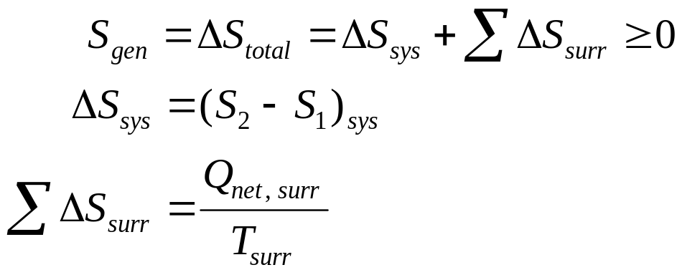
The adiabatic, reversible process is a constant entropy process and is called isentropic. As will be shown later for an ideal gas, the adiabatic, reversible process is the same as the polytropic process where the polytropic exponent n = k = C_{p}/C_{v}.
The principle of increase of entropy for a closed system exchanging heat with its surroundings at a constant temperature T_{surr} is found by using the equation for the entropy generated for an isolated system.
Surroundings
T_{surr}
A general closed system (a cup of coffee) exchanging heat with its surroundings
Q_{out, sys}
System
Boundary

Slide 24
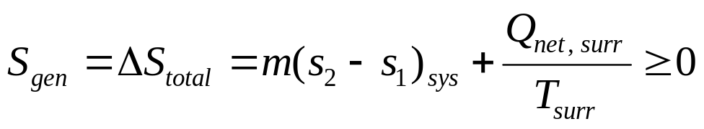
where
Effect of Heat Transfer on Entropy
Let's apply the second law to the following situation. Consider the transfer of heat from a heat reservoir at temperature T to a heat reservoir at temperature T - ΔT > 0 where ΔT > 0, as shown below.
HR
at
T
Two heat reservoirs exchanging heat over a
finite temperature difference
Q
HR
at
T-ΔT
The second law for the isolated system composed of the two heat reservoirs is

Slide 25
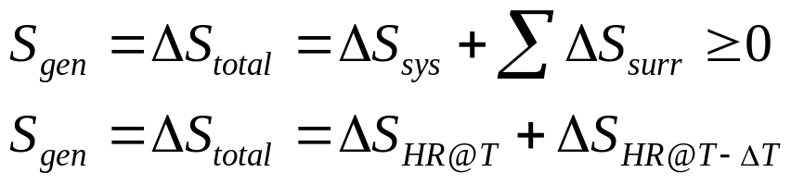
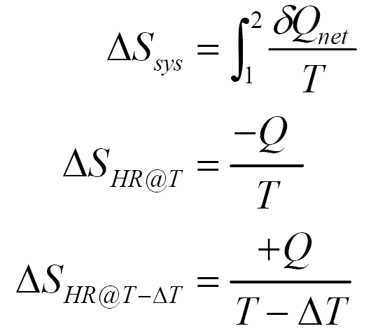
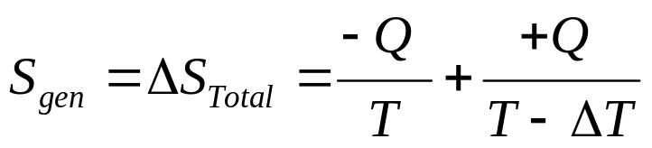
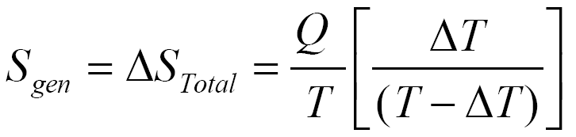
In general, if the heat reservoirs are internally reversible
Now as ΔT → 0, S_{gen} → 0 and the process becomes totally reversible. Therefore, for reversible heat transfer ΔT must be small. As ΔT gets large, S_{gen} increases and the process becomes irreversible.

Slide 26
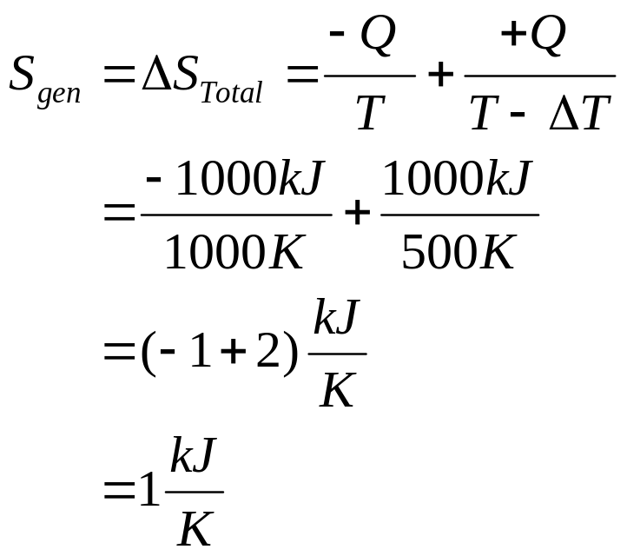
Example 7-3
Find the total entropy change, or entropy generation, for the transfer of 1000 kJ of heat energy from a heat reservoir at 1000 K to a heat reservoir at 500 K.
HR
at
T=1000 K
T
Areas
= 1000 kJ
1000 K
Q=1000 kJ
HR
at
T-ΔT = 500K
500 K
0 1 2 S, kJ/K
The second law for the isolated system is

Slide 27
What happens when the low-temperature reservoir is at 750 K?
The effect of decreasing the ΔT for heat transfer is to reduce the entropy generation or total entropy change of the universe due to the isolated system and the irreversibilities associated with the heat transfer process.
Third Law of Thermodynamics
The third law of thermodynamics states that the entropy of a pure crystalline substance at absolute zero temperature is zero. This law provides an absolute reference point for the determination of entropy. The entropy determined relative to this point is called absolute entropy.
Entropy as a Property
Entropy is a property, and it can be expressed in terms of more familiar properties (P,v,T) through the Tds relations. These relations come from the analysis of a reversible closed system that does boundary work and has heat added. Writing the first law for the closed system in differential form on a per unit mass basis
δQ_{int rev}
δW_{int rev, out}
System used to find expressions for ds

Slide 28



On a unit mass basis we obtain the first Tds equation, or Gibbs equation, as
Recall that the enthalpy is related to the internal energy by h = u + Pv. Using this relation in the above equation, the second Tds equation is
These last two relations have many uses in thermodynamics and serve as the starting point in developing entropy-change relations for processes. The successful use of Tds relations depends on the availability of property relations. Such relations do not exist in an easily used form for a general pure substance but are available for incompressible substances (liquids, solids) and ideal gases. So, for the general pure substance, such as water and the refrigerants, we must resort to property tables to find values of entropy and entropy changes.

Slide 29


The temperature-entropy and enthalpy-entropy diagrams for water are shown below.

Slide 30

Shown above are the temperature-entropy and enthalpy-entropy diagrams for water. The h-s diagram, called the Mollier diagram, is a useful aid in solving steam power plant problems.

Slide 31
Example 7-4
Find the entropy and/or temperature of steam at the following states:
P | T | Region | s kJ/(kg K)
5 MPa | 120ºC
1 MPa | 50ºC
1.8 MPa | 400ºC
40 kPa |  | Quality, x = 0.9
40 kPa |  |  | 7.1794
(Answers are on the last page of Chapter 7.)

Slide 32
Example 7-5
Determine the entropy change of water contained in a closed system as it changes phase from saturated liquid to saturated vapor when the pressure is 0.1 MPa and constant. Why is the entropy change positive for this process?
System: The water contained in the system (a piston-cylinder device)
T
Steam
s
Property Relation: Steam tables
Process and Process Diagram: Constant pressure (sketch the process relative to the saturation lines)
Conservation Principles: Using the definition of entropy change, the entropy change of the water per mass is

Slide 33

The entropy change is positive because: (Heat is added to the water.)
Example 7-6
Steam at 1 MPa, 600oC, expands in a turbine to 0.01 MPa. If the process is isentropic, find the final temperature, the final enthalpy of the steam, and the turbine work.
System: The control volume formed by the turbine
T
1
W_{out}
Control surface
2
s

Slide 34


Property Relation: Steam tables
Process and Process Diagram: Isentropic (sketch the process relative to the saturation lines on the T-s diagram)
Conservation Principles:
Assume: steady-state, steady-flow, one entrance, one exit, neglect KE and PE
Conservation of mass:
First Law or conservation of energy:
The process is isentropic and thus adiabatic and reversible; therefore Q = 0. The conservation of energy becomes

Slide 35


Since the mass flow rates in and out are equal, solve for the work done per unit mass
Now, let’s go to the steam tables to find the h’s.
The process is isentropic, therefore; s₂ = s₁ = 8.0311 kJ/(kg K )
At P₂ = 0.01 MPa, s_{f} = 0.6492 kJ/kg⋅K, and s_{g} = 8.1488 kJ/(kg K);
thus, s_{f} < s₂ < s_{g}.
State 2 is in the saturation region, and the quality is needed to specify the state.

Slide 36


Since state 2 is in the two-phase region, T₂ = T_{sat at P2} = 45.81ºC.

Slide 37





Entropy Change and Isentropic Processes
The entropy-change and isentropic relations for a process can be sum­marized as
follows:
1.Pure substances:
Any process: (kJ/kg⋅K)
Isentropic process:
2.Incompressible substances (Liquids and Solids):
The change in internal energy and volume for an incompressible substance is
The entropy change now becomes

Slide 38



If the specific heat for the incompressible substance is constant, then the entropy change is
Any process: (kJ/kg⋅K)
Isentropic process:
3. Ideal gases:
a.Constant specific heats (approximate treatment):
Any process: (can you fill in the steps?)
(kJ/kg⋅K)

Slide 39



and (can you fill in the steps?)
(kJ/kg⋅K)
Or, on a unit-mole basis,
(kJ/kmol⋅K)
and
(kJ/kmol⋅K)
Isentropic process: (Can you fill in the steps here?)

Slide 40




For an isentropic process this last result looks like Pv^{k} = constant which is the polytropic process equation Pv^{n} = con­stant with n = k = C_{p}/C_{v}.
b.Variable specific heats (exact treatment):
From Tds = dh - vdP, we obtain
The first term can be integrated relative to a reference state at temperature T_{ref}.

Slide 41


The integrals on the right-hand side of the above equation are called the standard state entropies, sº, at state 1, T₁, and state 2, T₂; so is a function of temperature only.

Slide 42



Therefore, for any process:
(kJ/kg⋅K)
or
(kJ/kmol⋅K)
The standard state entropies are found in Tables A-17 for air on a mass basis and Tables A-18 through A-25 for other gases on a mole basis. When using this variable specific heat approach to finding the entropy change for an ideal gas, remember to include the pressure term along with the standard state entropy terms--the tables don’t warn you to do this.
Isentropic process: Δs = 0
(kJ/kg⋅K)
If we are given T₁, P₁, and P₂, we find sº₁ at T₁, calculate sº₂, and then determine from the tables T₂, u₂, and h₂.
When air undergoes an isentropic process when variable specific heat data are required, there is another approach to finding the properties at the end of the isentropic process. Consider the entropy change written as

Slide 43



Letting T₁ = T_{ref}, P₁ = P_{ref} = 1atm, T₂ = T, P₂ = P, and setting the entropy change equal to zero yield
We define the relative pressure P_{r} as the above pressure ratio. P_{r} is the pressure ratio necessary to have an isentropic process between the reference temperature and the actual temperature and is a function of the actual temperature. This parameter is a function of temperature only and is found in the air tables, Table A-17. The relative pressure is not available for other gases in this text.
The ratio of pressures in an isentropic process is related to the ratio of relative pressures.

Slide 44


There is a second approach to finding data at the end of an ideal gas isentropic process when variable specific heat data are required. Consider the following entropy change equation set equal to zero.
From Tds = du + Pdv, we obtain for ideal gases
Letting T₁ = T_{ref}, v₁ = v_{ref}, T₂ = T, v₂ = v, and setting the entropy change equal to zero yield
We define the relative volume v_{r} as the above volume ratio. v_{r} is the volume ratio necessary to have an isentropic process between the reference temperature and the actual temperature and is a function of the actual temperature. This parameter is a function of temperature only and is found in the air tables, Table A-17. The relative volume is not available for other gases in this text.

Slide 45

Extra Assignment
For an ideal gas having constant specific heats and undergoing a polytropic process in a closed system, Pv^{n} = constant, with n = k, find the heat transfer by applying the first law. Based on the above discussion of isentropic processes, explain your answer. Compare your results to this problem to a similar extra assignment problem in Chapter 4.
Example 7-7
Aluminum at 100oC is placed in a large, insulated tank having 10 kg of water at a temperature of 30oC. If the mass of the aluminum is 0.5 kg, find the final equilibrium temperature of the aluminum and water, the entropy change of the aluminum and the water, and the total entropy change of the universe because of this process. Before we work the problem, what do you think the answers ought to be? Are entropy changes going to be positive or negative? What about the entropy generated as the process takes place?

Slide 46

System: Closed system including the aluminum and water.
Water
Tank insulated
boundary
AL
Property Relation: ?
Process: Constant volume, adiabatic, no work energy exchange between the aluminum and water.
Conservation Principles:
Apply the first law, closed system to the aluminum-water system.
Using the solid and incompressible liquid relations, we have

Slide 47



But at equilibrium, T_{2,AL} = T_{2,water} = T₂
The second law gives the entropy production, or total entropy change of the universe, as
Using the entropy change equation for solids and liquids,
Why is S_{gen} or ΔS_{Total} positive?

Slide 48

Example 7-8
Carbon dioxide initially at 50 kPa, 400 K, undergoes a process in a closed system until its pressure and temperature are 2 MPa and 800 K, respectively. Assuming ideal gas behavior, find the entropy change of the carbon dioxide by first assuming constant specific heats and then assuming variable specific heats. Compare your results with the real gas data obtained from the EES software.
(a) Assume the Table A-2(a) data at 300 K are adequate; then C_{p} = 0.846 kJ/kg⋅K and R = 0.1889 kJ/kg-K.

Slide 49

(b) For variable specific heat data, use the carbon dioxide data from Table A-20.
(c) Using EES for carbon dioxide as a real gas:
Deltas=ENTROPY(CarbonDioxide,T=800,P=2000)-
ENTROPY(CarbonDioxide,T=400,P=50)
= +0.03452 kJ/kg⋅K
(d) Repeat the constant specific heat calculation assuming C_{p} is a constant at the average of the specific heats for the temperatures. Then C_{p} = 1.054 kJ/kg⋅K (see Table A-2(b)).

Slide 50

It looks like the 300 K data give completely incorrect results here.
If the compression process is adiabatic, why is Δs positive for this process?

Slide 51


Why is ΔS_{AL} negative? Why is ΔS_{water} positive?

